Slide 1


Effects of Parameter Variation on Planetesimal Thermal Modeling
1
Jonas Hallstrom, Dr. Maitrayee Bose
Arizona State University
Arizona NASA Space Grant Statewide Symposium

Slide 2
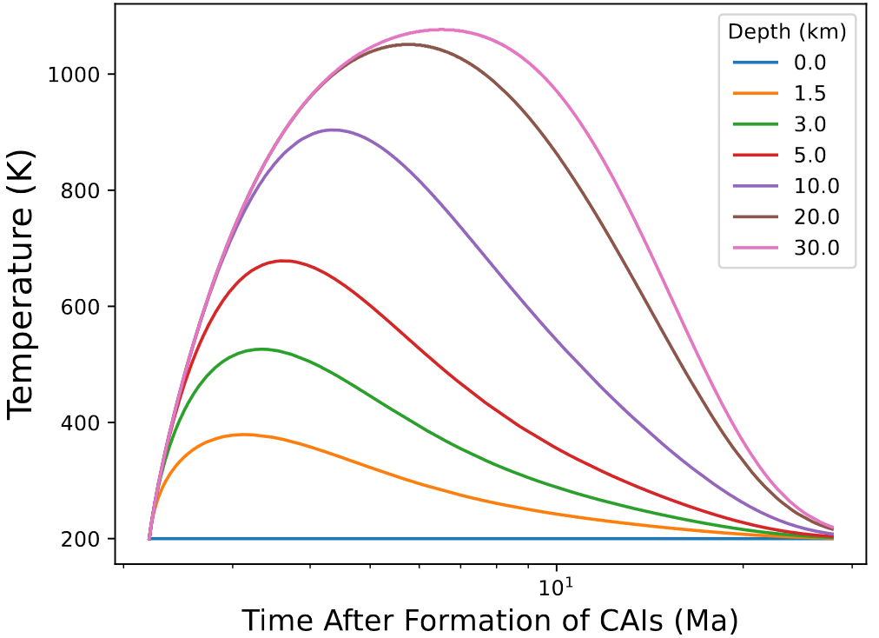
Introduction and motivation
2
30 km radius, 2.2 Myrs accretion:
Asteroids originated in <200 km sized parent bodies in the early solar system
Analysis of asteroid Itokawa samples provided thermal constraints on Itokawa’s parent body
Thermal evolution models can use thermal constraints to predict other properties of parent bodies, particularly their size and formation time
Past studies have constrained Itokawa’s parent body to have been accreted between 1.9 and 2.2 million years (Myrs or Ma) after the beginning of the solar system (CAI formation) with a radius greater than 20 km (Wakita et al. 2013)

Slide 3
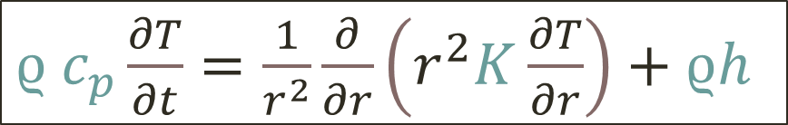
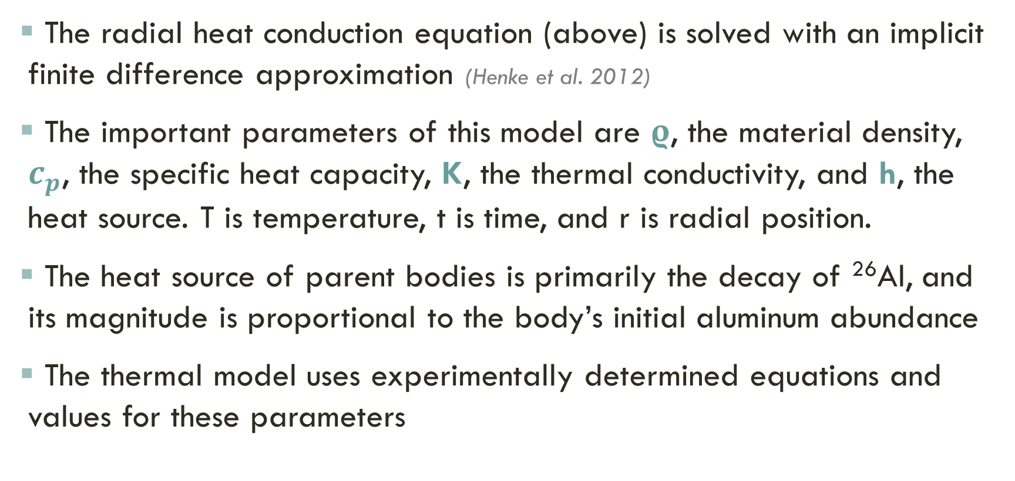
Thermal modeling
3
$ϱ c_{p}\frac{∂T}{∂t}=\frac{1}{r^{2}}\frac{∂}{∂r}\left(r^{2}K\frac{∂T}{∂r}\right)+ϱh$
The radial heat conduction equation (above) is solved with an implicit finite difference approximation (Henke et al. 2012)
The important parameters of this model are $ρ$, the material density, $c_{p}$, the specific heat capacity, K, the thermal conductivity, and h, the heat source. T is temperature, t is time, and r is radial position.
The heat source of parent bodies is primarily the decay of ²⁶Al, and its magnitude is proportional to the body’s initial aluminum abundance
The thermal model uses experimentally determined equations and values for these parameters

Slide 4
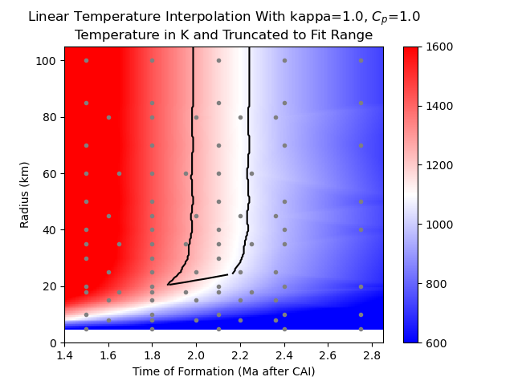
applying thermal constraints
4
+
The max core temperatures of several simulated parent bodies with varying radius and formation time values were collected (grey dots) and interpolated (color map)
The thermal constraints (black lines) from Itokawa were then fitted to this data
These lines constrain the range of valid radius and formation time values for Itokawa’s parent body, if the model is perfectly correct
-

Slide 5
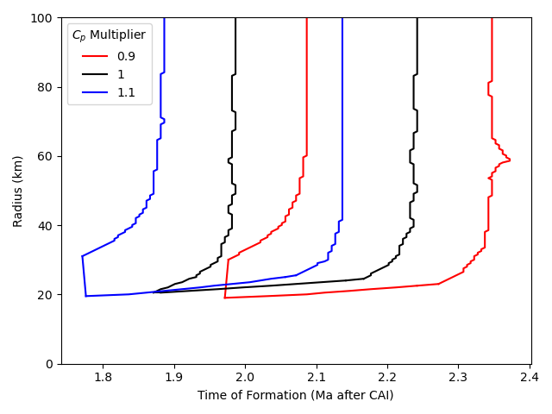
the effects of parameter uncertainty
5
The true range of allowed radius and formation time values must account for any uncertainties in the model
Conductivity, surface temperature, and density all have negligible effects
Varying heat capacity within uncertainty leads to significantly different results
Overlaying all the constraint graphs gives a larger range of formation times

Slide 6
the effects of parameter uncertainty
6
The effect of uncertainty in initial aluminum abundance is also significant and can be calculated mathematically
Varied Parameter: | Variation of Original Value: | Range of Suitable Formation Times (Myrs): | Percentage of Original Range:
None | --- | 1.9-2.2 | 100%
Heat Capacity | 90%-110%* | 1.8-2.3 | 165%
Aluminum Abundance | 88%-200%** | 1.75-2.9 | 380%
Heat Capacity and Aluminum Abundance | 90%-110% 88%-200% | 1.65-3.05 | 465%
* Wakita et al. 2013, ** Yomogida and Matsui 1983

Slide 7
Conclusions
7
The early solar system parent body of asteroid Itokawa could have formed between 1.65 and 3.05 Myrs after CAI formation with a radius greater than 20 km
The ability of thermal models to investigate the origins of Itokawa and similar asteroids is significantly affected by uncertainty in the aluminum abundance and the specific heat behavior of that asteroid’s material

Slide 8
Acknowledgements
8
I would like to thank Dr. Maitrayee Bose for her constant support and advice in this process of learning and research, and the rest of her students for our discussions.
Additionally, I would like to thank the ASU/NASA Space Grant for supporting and funding this project.

